Slide 1
WELCOME
Support AI Ticket Management Agent
OLLAMA
AI-powered internal support desk for ticket raising, tracking and resolution
Local LLM inference
OLLAMA
AI AGENT
TICKETING
DASHBOARD
AI SUPPORT AGENT
User issue → response
Presented by
Leela Lakshmi Sai Ram Nakka
B.Tech — Electronics & Communication Engineering Vishnu Institute of Technology • August 2026

Slide 2
01 • MOTIVATION
Problem statement
A support team can become overloaded when every small hardware, credential or software issue requires a formal ticket.
01
Ticket overload
02
Delayed attention
03
Limited self-service
Routine issues inflate the support queue.
Support staff spend time on low-complexity requests.
Employees need immediate guidance before raising a ticket.
PROJECT RESPONSE
EMPLOYEE
OLLAMA AI
RESOLVE
TICKET
Describes issue
Conversational help
Self-service
Human support
SUPPORT AI TICKET MANAGEMENT AGENT • OLLAMA-POWERED SUPPORT
02

Slide 3
02 • GOALS
Project objectives
01
Secure access
02
Live dashboard
03
Structured tickets
Sign-up and sign-in for verified employees.
Total, open, in-progress and resolved ticket counts.
Department, subject and priority classification.
04
Searchable queue
05
AI self-service
06
Responsive UI
Filter and search tickets across the team.
Answer common support questions in chat.
Consistent experience with light/dark mode support.
Design principle
Self-service first → formal ticket when intervention is actually required.
SUPPORT AI TICKET MANAGEMENT AGENT • OLLAMA-POWERED SUPPORT
03

Slide 4
03 • SOLUTION
End-to-end workflow
01
02
03
04
05
SIGN IN
DASHBOARD
OLLAMA AI
RAISE TICKET
TRACK
SIGN IN
DASHBOARD
OLLAMA AI
RAISE TICKET
TRACK
Verified identity
Live ticket state
Instant guidance
Only if needed
Search + status
AI
AI path
TK
Ticket path
OP
Operations path
Ask a question → receive conversational troubleshooting guidance.
Capture issue details → support team tracks lifecycle.
Search/filter queue → focus attention where it matters.
SUPPORT AI TICKET MANAGEMENT AGENT • OLLAMA-POWERED SUPPORT
04

Slide 5
04 • TECHNICAL DESIGN
System architecture
The application is organized as a modular support platform with an AI layer connected to the user experience.
USER / UI
WEB APPLICATION
AUTHENTICATION
AI CHAT
TICKET UI
Dashboard • Tickets • AI
Sign-up / Sign-in
Ollama-powered agent
Raise / Search / Filter
SERVICE LAYER
REST-STYLE BACKEND
OLLAMA INTEGRATION
Auth + Ticket CRUD
Local model inference
DATA LAYER
PERSISTENT DATA STORE
Accounts + ticket queue
SUPPORT AI TICKET MANAGEMENT AGENT • OLLAMA-POWERED SUPPORT
05

Slide 6
05 • TECHNOLOGIES
Technology stack
WEB
FRONTEND
API
BACKEND
DB
DATA
Single-page responsive interface Collapsible sidebar Light / dark mode
REST-style service Authentication Ticket CRUD
Persistent accounts Shared ticket queue Search / filtering
AI
OLLAMA
AUTH
SECURITY
UX
UX
Local LLM integration Conversational support AI-assisted troubleshooting
Verified employee identity Protected support desk Identity-linked activity
Responsive layout Consistent modules Support-focused workflow
Important update: this presentation uses OLLAMA as the project's AI technology — not Google Gemini.
SUPPORT AI TICKET MANAGEMENT AGENT • OLLAMA-POWERED SUPPORT
06

Slide 7
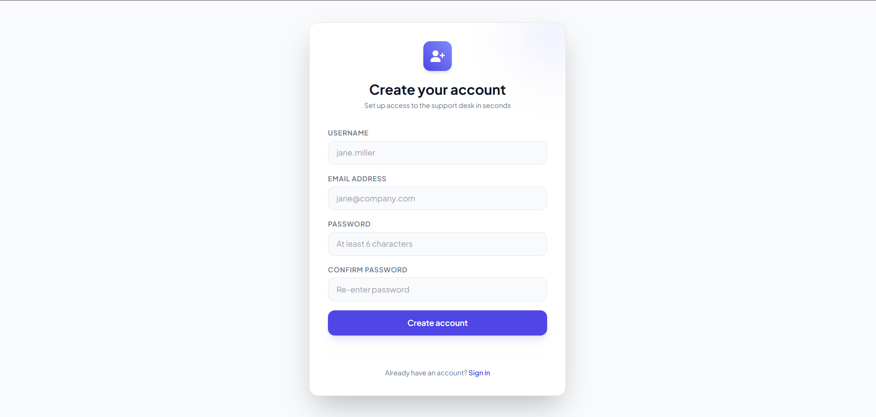
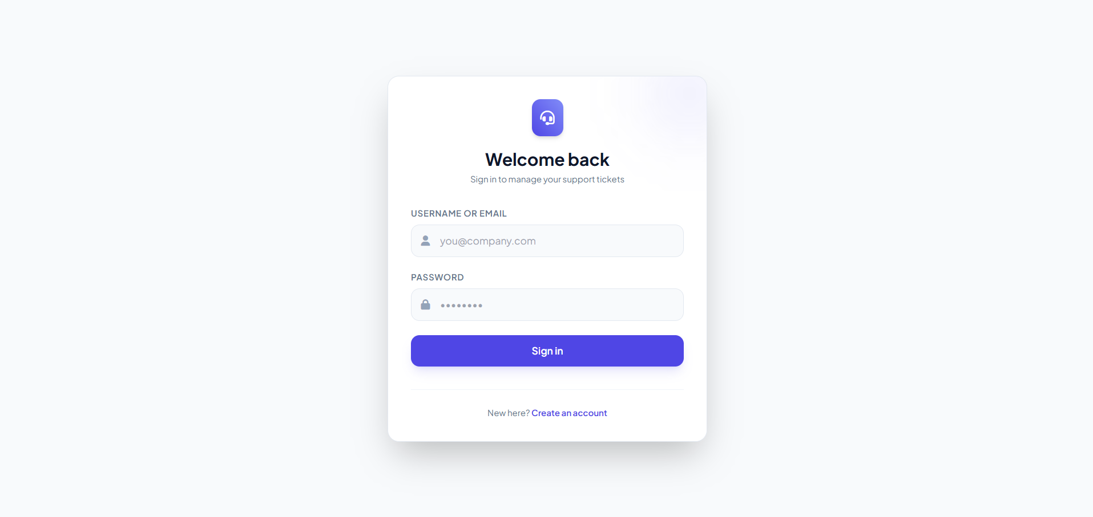
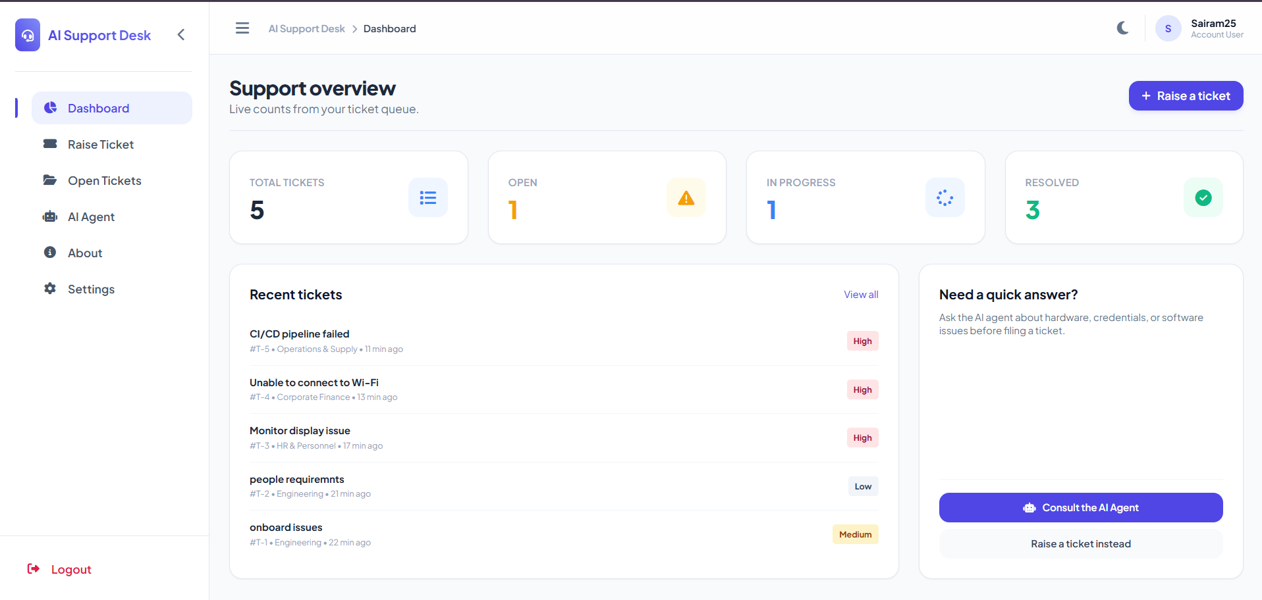
06 • PRODUCT EXPERIENCE
Application walkthrough — access & dashboard
Authentication connects the employee identity to tickets and AI-agent activity.
CREATE ACCOUNT
SIGN IN
SUPPORT OVERVIEW
✓
Dashboard
Live ticket counts, recent tickets and quick actions to use the AI Agent or raise a ticket.
SUPPORT AI TICKET MANAGEMENT AGENT • OLLAMA-POWERED SUPPORT
07

Slide 8
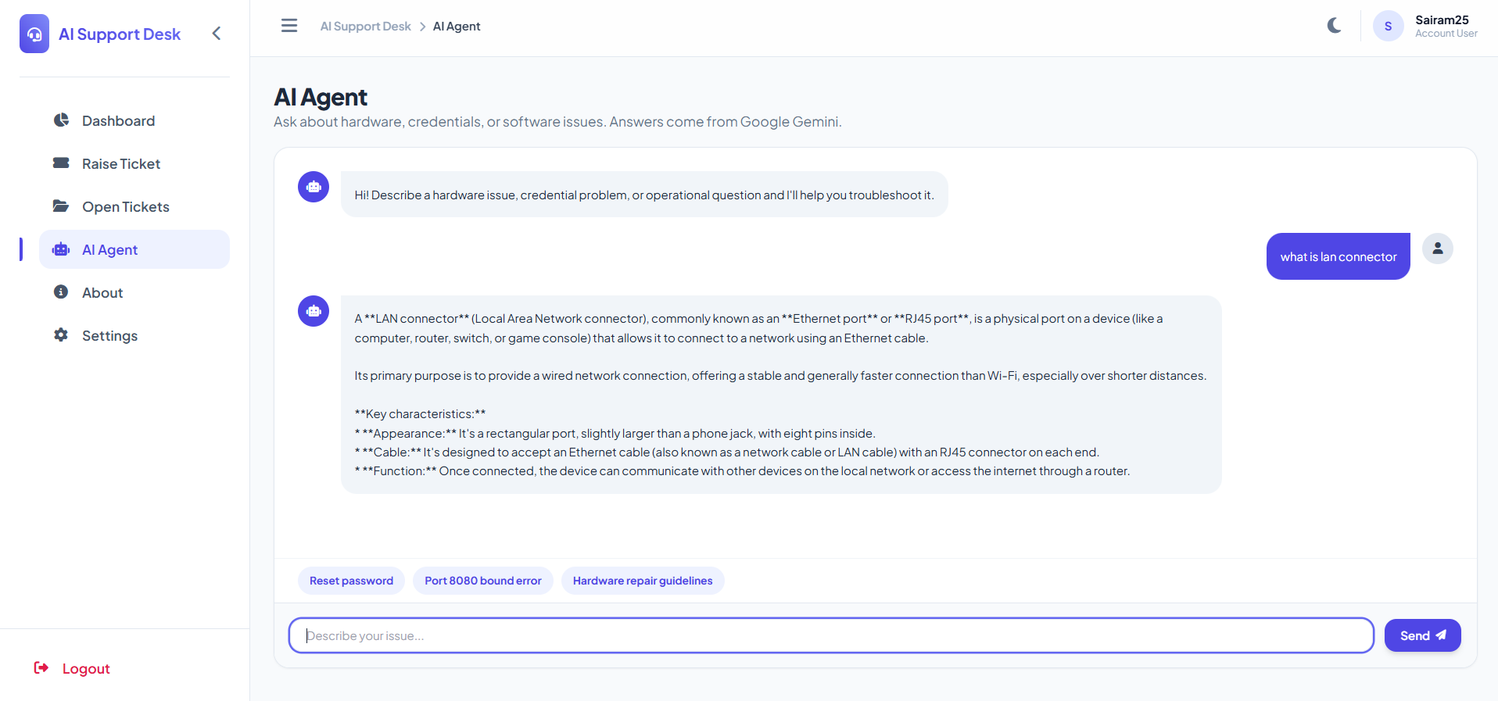
07 • AI CAPABILITY
Ollama AI Agent
The AI Agent provides conversational support for hardware, credential and operational questions using an Ollama model.
01
Local AI inference
Ollama runs the selected language model locally.
02
Natural interaction
Users describe issues in normal conversational language.
03
Self-service first
AI guidance can resolve routine issues before ticket creation.
OLLAMA → MODEL → RESPONSE
SUPPORT AI TICKET MANAGEMENT AGENT • OLLAMA-POWERED SUPPORT
08

Slide 9
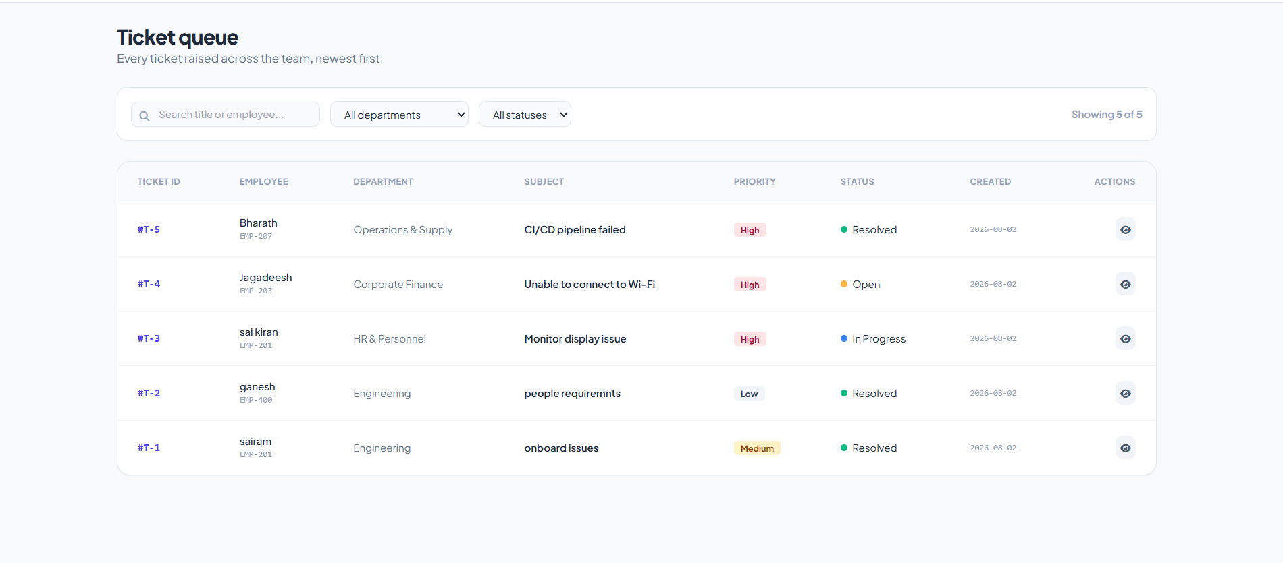
08 • CORE WORKFLOW
Ticket management
TRACKED FIELDS
Ticket ID
Employee
Department
Subject
Priority
Status
Created
QUEUE CONTROLS
• Newest first
• Search by title / employee
• Filter by department / status
• Centralized team visibility
SUPPORT AI TICKET MANAGEMENT AGENT • OLLAMA-POWERED SUPPORT
09

Slide 10
09 • PRODUCT HIGHLIGHTS
Feature map & user experience
01
Dashboard
02
Raise Ticket
03
Open Tickets
Live ticket overview
Department + subject + priority
Search + filters
04
AI Agent
05
About
06
Settings
Ollama conversational support
Project information
Application controls
Persistent sidebar • Responsive single-page UI • Light/dark mode • Consistent navigation
SUPPORT AI TICKET MANAGEMENT AGENT • OLLAMA-POWERED SUPPORT
10

Slide 11
10 • RESULTS + NEXT STEPS
Outcome & future scope
01
Delivered
02
Self-service
03
Visibility
04
Responsive UI
Secure support desk with ticket lifecycle tracking and AI-assisted troubleshooting.
Users can attempt AI-based resolution before creating a ticket.
Support staff get a centralized, filterable ticket queue.
Consistent experience with dark-mode support.
FUTURE EXTENSIONS
Automated ticket triage
AI priority suggestions
Recurring issue analytics
Smarter support insights
The modular architecture makes future AI automation and analytics straightforward to add.
SUPPORT AI TICKET MANAGEMENT AGENT • OLLAMA-POWERED SUPPORT
11

Slide 12
THANK YOU
Support AI Ticket Management Agent
PROJECT PRESENTED BY
Leela Lakshmi Sai Ram Nakka
B.Tech — Electronics and Communication Engineering
Vishnu Institute of Technology
OLLAMA • AI AGENT • TICKETING • DASHBOARD
Project Presentation • August 2026
SUPPORT AI TICKET MANAGEMENT AGENT • OLLAMA-POWERED SUPPORT
12

